Slide 1
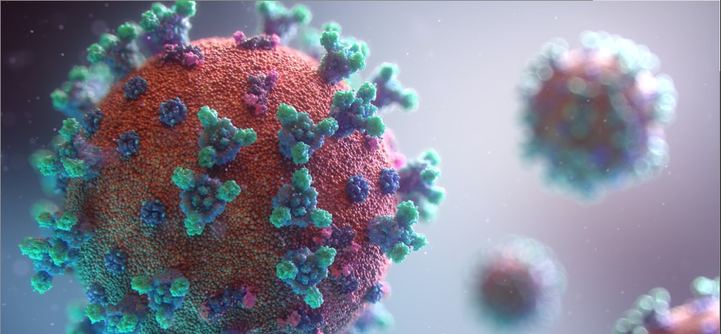
COVID-19 Day 631 Press Update
December 1, 2021
DOH Acting Secretary David R. Scrase, M.D., M.H.S.A.
DOH State Epidemiologist, Christine Ross, M.D., M.P.H.
ALTSD Cabinet Secretary Katrina Hotrum-Lopez

Slide 2
Yesterday’s Epidemiology Report
 | Yesterday | Since March 2020 | Percent
Cases | 1,132 | 314,264 | 15.0% of NM population
Hospitalizations | 633 | 20,559 | 6.5% of cases
Deaths | 12 | 5,367 | 1.7% of cases

Slide 3
Full vaccination is still NM’s first priority

Slide 4
NM COVID-19 vaccination rates
Fully vaccinated:
62.0% of ALL New Mexicans (38.0% unvaccinated)
74.4% of New Mexicans 18+
55.5% of New Mexicans 12-17
0.3% of New Mexicans 5-11
Partially vaccinated:
72.9% of ALL New Mexicans (27.1% unvaccinated)
85.7% of New Mexicans 18+
64.6% of New Mexicans 12-17
16.2% of New Mexicans 5-11
Received a booster dose:
370,082 New Mexicans 18+
<18 not eligible
91.1%
90.5%
90.8%
92.5%
92.0%
https://vaccinenm.org/public-dashboard.html

Slide 5
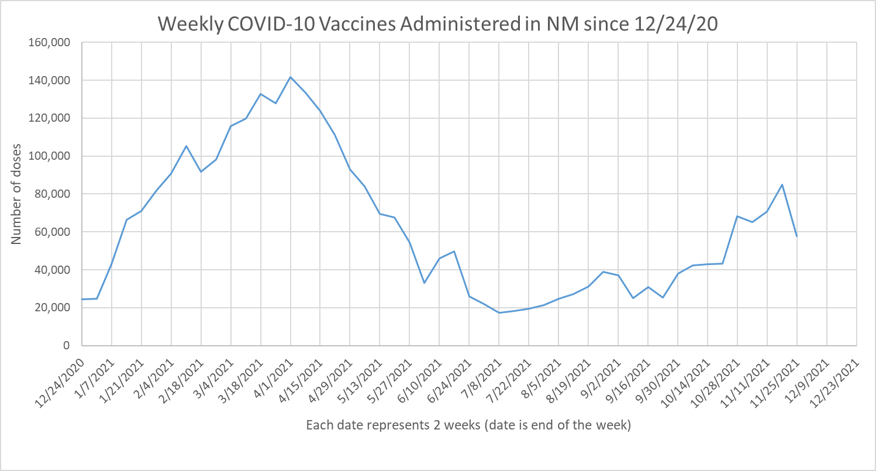
84,896 doses 11/12 -11/18
Notes:
Source?

Slide 6
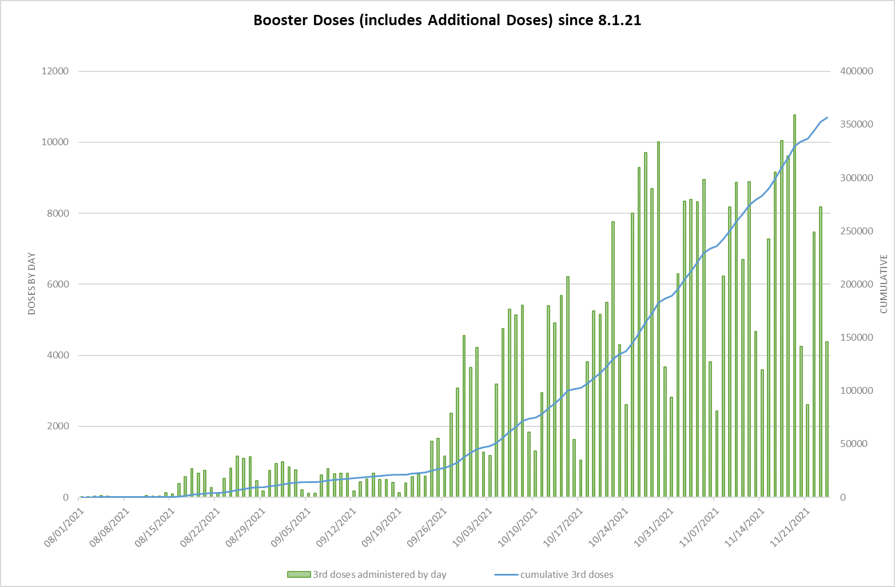
Booster dose administration progress
370,082 total booster doses administered 8/1–11/17
Currently, NM is administering booster doses ahead of the national average
Still, not enough people are receiving their booster
15% increase over last week

Slide 7
More booster appointments are being added daily
Appointments for boosters as of 11/30/21:
109,557 appointments
63,287 already filled (58%)
46,270 open (42%)
Other appointments and walk-ins available statewide
Visit VaccineNM.org or vaccines.gov to find a location near you
Booster Appointments in the NM Vaccine Registration System

Slide 8
Call for Providers: We need your help administering booster doses
If you are a vaccine provider, we need your help, especially in Santa Fe, Española, and Albuquerque
If you are not a provider, consider becoming one: signup at takecarenm.org
Providers are trusted! Please share importance of boosters with your patients to address waning immunity and variants
Emphasize that patients don’t need insurance and that the vaccine is free
https://www.santafenewmexican.com/news/local_news/covid-19-boosters-offered-at-santa-fe-railyard-event/article_9308ebfa-48d3-11ec-ba1d-37add1f54107.html

Slide 9
Vaccines for Children

Slide 10
5-11 year-olds vaccine distribution is on track

Slide 11
5-11 year-olds appointments are widely available
Appointments for 5-11 year-olds as of 11/30/21:
20,557 appointments
2,559 already filled (12%)
17,998 open (88%)
Visit VaccineNM.org/kids to schedule a child vaccine today
Pediatric Appointments in the NM Vaccine Registration System

Slide 12
COVID-19 Epidemiology Update

Slide 13
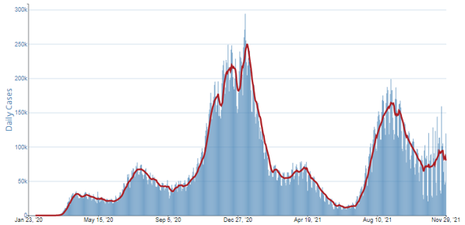
National update – high rate of COVID-19 cases
US COVID-19 7-Day Case Rate per 100,000, by State/Territory
Daily Trends in Number of COVID-19 Cases in the US Reported to the CDC
https://covid.cdc.gov/covid-data-tracker/#cases_casesper100klast7days ; https://covid.cdc.gov/covid-data-tracker/#trends_dailycases

Slide 14
10 cases per 100,000
Total NM cases
Total NM 7-day rolling average
https://cvmodeling.nmhealth.org/

Slide 15
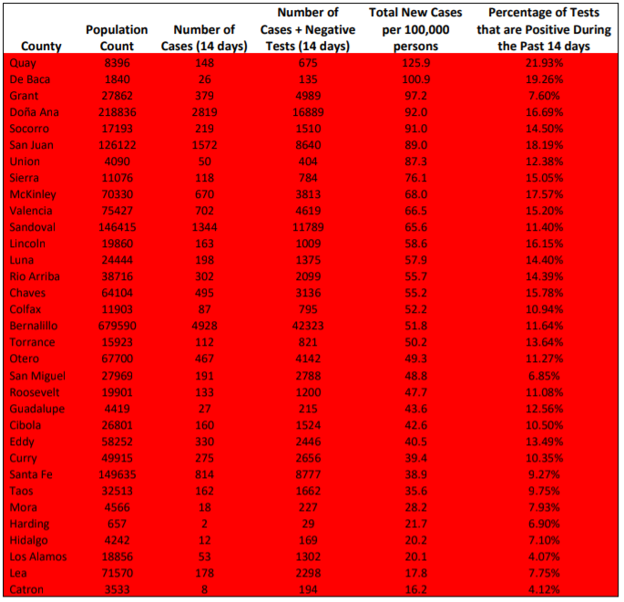
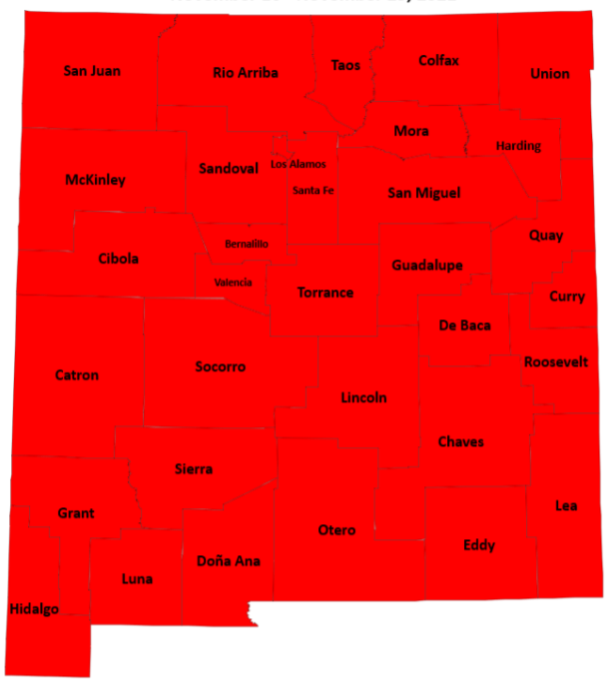
All of NM is a high-risk setting
Levels of Community Transmission by County, November 16-29, 2021
https://cv.nmhealth.org/wp-content/uploads/2021/11/County_Data_Report_11.30.21.pdf

Slide 16
Spread rate is now below 1.0, a key threshold

Slide 17
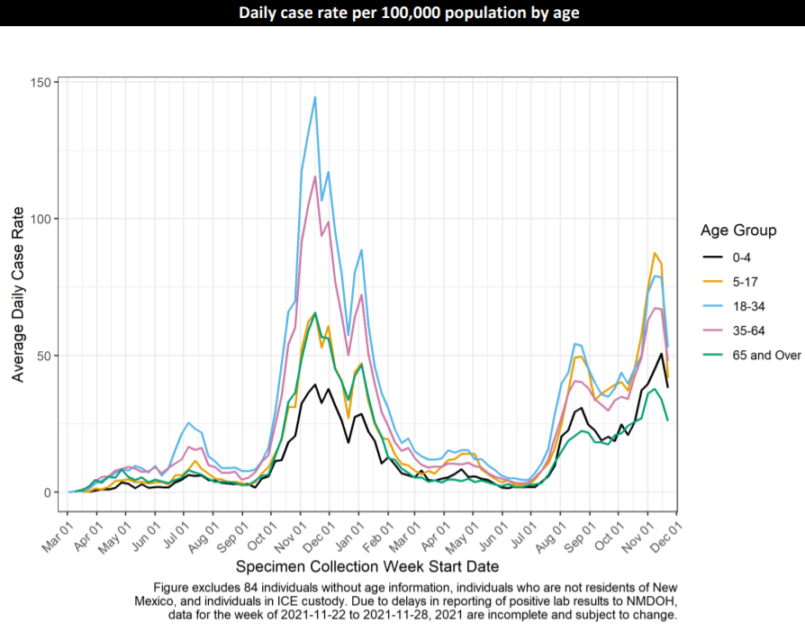
Rising incidence of COVID-19 among all ages in New Mexico
Demographics Report https://cv.nmhealth.org/epidemiology-reports/
Notes:
David

Slide 18
November 29, 2021: 12.7%
Target: 7.5%

Slide 19
Omicron Variant (B.1.1.529)
Omicron was designated a new variant of concern by the WHO on Friday, 11/26/21
To date, this new variant has not been identified in New Mexico
This new variant has been identified in eight South African countries, UK, Israel, Germany, Botswana, Hong Kong, and others
Little data is available on Omicron’s spread rate, resistance to vaccine, etc.
 | Alpha | Delta | Omicron
First identified | England | India | S. Africa
Detected by Routine Testing? | Yes | Yes | Yes
Spread Rate | 1.5 X | 3-5 X | ?
Hospitalizations/ Deaths | No increase | Possible increase | ?
Resistance to Treatment | Yes | Yes | ?
Resistance to Vaccine | No | No | ?
Peak percentage in New Mexico | 72% | 99.9% | N/A
Current NM Percentage Estimate | 0% | 99.9% | 0%

Slide 20
Omicron – best means of protection remains vaccination

Slide 21
Highly contagious Delta variant remains predominant variant in current surge
Variant of Concern Report https://cv.nmhealth.org/epidemiology-reports/

Slide 22
Long-Term Care Facility Update
COVID-19 Response
December 1st, 2021
Secretary Katrina Hotrum-Lopez

Slide 23
LTC FACILITIES – WEEKLY COVID-19 CASES
Public Health Order 9/15/2021

Slide 24
New LTCF COVID-19 Cases 11/22 to 11/29
Sandoval County Facilities had the greatest number of new cases (37)
Bernalillo County facilities had the second highest number of new cases (33)
Harding County facilities had the third highest number of new cases (24)
*Los Alamos County: 0 new cases for the week.
Source: Srikanth Paladugu NMDOH, Governors request files. Compiled and analyzed by UNM ISR's Center for Applied Research and Analysis (CARA).
Data Current As Of 11/22/2021
Slide Updated 12/1/2021

Slide 25
Daily LTC deaths are 10.8% of the pre-vaccine daily average.
Since the vaccine rollout, the average number of daily deaths in all LTCs has decreased from nearly 10 deaths a day, to less than one death per day.
Data Current As Of 11/26/2021

Slide 26
Thanks to our LTC staff for protecting vulnerable older adults
 | Staff vaccination rate | Staff exemption rate | Non-direct care staff vaccination rate | Residents vaccination rate
Long-Term Care Facilities | >92% | 7% | <1% | 91%

Slide 27
Thank you!

Slide 28
Vaccine Breakthrough Cases

Slide 29
Percent of Cases, Hospitalizations, and Deaths by Vaccine Status: November 1 - 29, 2021
Risk of Vaccine Breakthrough case ~4x higher in those who completed initial series prior to 6/1/21, compared to those who completed it after 6/1/2021
Vaccination Report https://cv.nmhealth.org/epidemiology-reports/

Slide 30
Unvaccinated New Mexicans die 15 years younger and at much higher rates than the vaccinated
Older individuals have higher vaccine uptake (more likely to be vaccinated and vice versa)
Older individuals are more likely to have multiple comorbidities that put them at risk for more severe disease (and hospitalization and death)
Increased age appears to be an independent risk factor for severe disease/death
Median Age of Hospitalizations and Deaths by Vaccine Status
 | 02/02/21 - 07/14/2021 (pre-Delta) | 07/14/21 - 11/16/21 (Delta in NM)
Vaccinated Hospitalizations | 69.0 | 70.2
Unvaccinated Hospitalizations | 56.1 | 55.3
Vaccinated Deaths | 77.2 | 78.9
Unvaccinated Deaths | 69.3 | 64.9

Slide 31
NM COVID-19 Hospitalizations and Deaths

Slide 32
Self-evaluation data not collected between 3/3/21 and 8/17/21.

Slide 33
Projection for NM hospitalizations appear to be on a decline

Slide 34
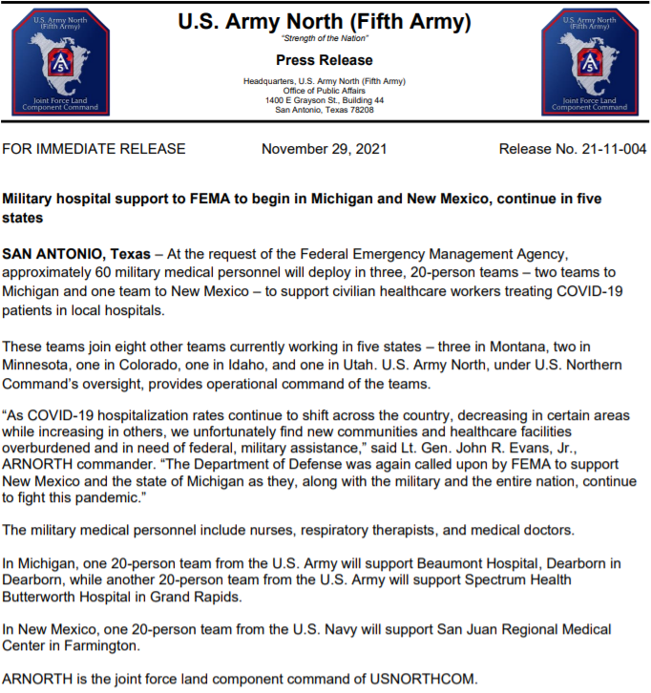
Staffing Assistance for New Mexico Hospitals
Facility | State | Federal
Lovelace Medical Center and Heart Hospital (ABQ) | 33
Eastern NM Medical Center (Roswell) | 28
San Juan Regional Medical Center (Farmington) | 26 | 70
Gallup Indian Medical Center (Gallup) | 23
Memorial Medical Center (Las Cruces) | 21
Mountain View Regional Medical Center (Las Cruces) | 21
Gerald Champion Regional Medical Center (Alamogordo) | 17
Alta Vista Regional Hospital (Las Vegas) | 17
Carlsbad Medical Center (Carlsbad) | 13
Lovelace Westside Hospital (ABQ) | 4
Lovelace Women's Hospital (ABQ) | 4
Los Alamos Medical Center (Los Alamos) | 4
Mimbres Memorial Hospital (Deming) | 3
TOTAL | 214 | 70
Staffing assistance is 100% reimbursable by FEMA
https://www.arnorth.army.mil/Portals/4/Documents/JFLCC%20Fact%20Sheets/PR%2021-11-004%20(Military%20hospital%20support%20to%20FEMA%20to%20begin%20in%20Michigan%20and%20New%20Mexico%20continue%20in%20five%20states).pdf

Slide 35
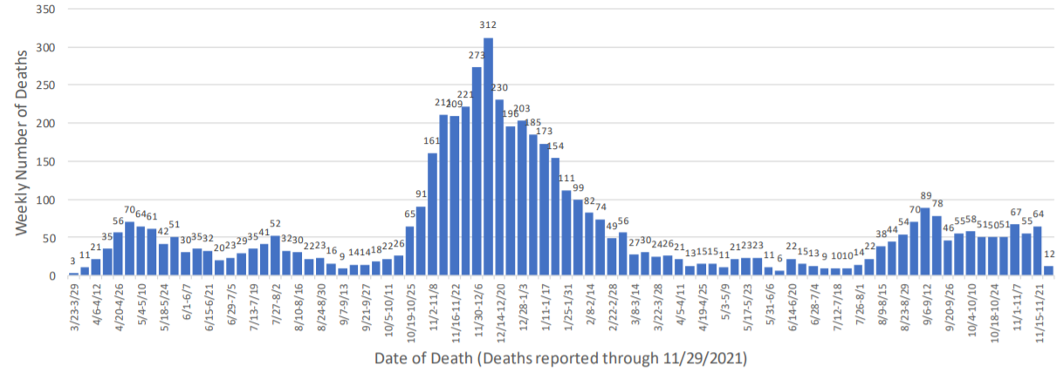
NM’s COVID-19 deaths have plateaued at a high level
5,367 New Mexico deaths as of 11/30/21
Mortality Report https://cv.nmhealth.org/epidemiology-reports/

Slide 36
COVID-19 Treatments

Slide 37
1,113 mAbs doses given this week!

Slide 38
mAbs provider spotlights
Below are the top outpatient mAbs providers from November 18-24. “Thank you!” to these facilities and all other NM mAbs providers:
Presbyterian Healthcare Services – 303
Eastern NM Medical Center – 155
Memorial Medical Center – 75
Gerald Champion Regional Medical Center – 73
Gallup Indian Medical Center – 67

Slide 39
Oral COVID-19 therapeutics
Several oral antivirals for the outpatient treatment of mild to moderate COVID-19 are in late-stage development
FDA advisory committee met on 11/30/21 and recommendations are expected soon, possibly by Friday
Initially, demand will be higher than available supply
Effectiveness in preventing infection still controversial but clear reduction in hospitalizations and deaths by as much as 90%
November 30, 2021: Antimicrobial Drugs Advisory Committee Meeting Announcement - 11/30/2021 - 11/30/2021 | FDA

Slide 40
Geographic locations and ages of reported ivermectin exposures in NM during 2021, 3 deaths
New Mexico Counties with Ivermectin Exposures Reported in 2021
14 total counties
Age range: 02-79 years old; Total Reports: 29

Slide 41
The pandemic is not over; Get vaccinated, get boosted!
Get tested if you think you have COVID-19 or have been exposed to someone who is positive.
If you have a COVID-19 positive test, symptoms and risk factors, seek out monoclonal antibody treatment.
Be especially careful indoors no matter where you live in NM.
CASE COUNTS REMAIN TOO HIGH. WE ALL STILL MUST FIGHT THE VIRUS.
Wash hands, clean surfaces, cough into tissue/elbow.
Everyone mask up and maintain social distancing (minimum 6’).
Get needed preventive healthcare.
Get vaccinated!

