Slide 1
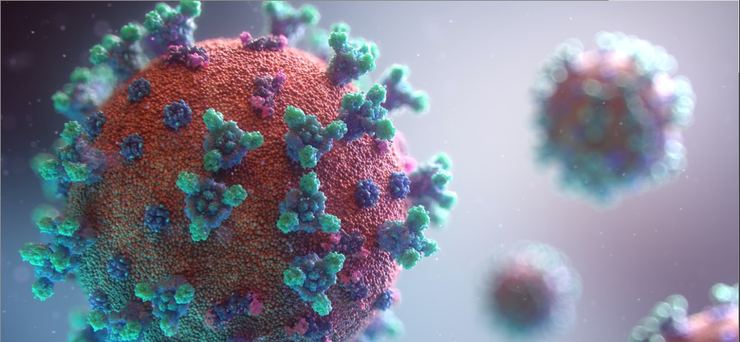
COVID-19 Day 638 Press Update
December 8, 2021
DOH Acting Secretary David R. Scrase, M.D., M.H.S.A.
DOH Deputy Secretary Laura C. Parajón, M.D., M.P.H.
DOH State Epidemiologist, Christine Ross, M.D., M.P.H.

Slide 2
Today’s Epidemiology Report
 | Today | Since March 2020 | Percent
Cases | 1,444 | 326,713 | 15.5% of NM population
Hospitalizations | 687 | 21,124 | 6.4% of cases
Deaths | 15 | 5,445 | 1.6% of cases

Slide 3
NM COVID-19 vaccination rates
Fully vaccinated:
62.8% of ALL New Mexicans (37.2% not fully vaccinated)
74.8% of New Mexicans 18+
55.9% of New Mexicans 12-17
5.2% of New Mexicans 5-11
Partially vaccinated:
73.9% of ALL New Mexicans (26.1% unvaccinated)
86.6% of New Mexicans 18+
65.0% of New Mexicans 12-17
19.5% of New Mexicans 5-11
Received a booster dose:
422,185 New Mexicans 18+
<18 not eligible
91.1%
90.5%
90.8%
92.5%
92.0%
NM 7-Day Moving Average US 7-Day Moving Average
https://vaccinenm.org/public-dashboard.html ; CDC COVID Data Tracker

Slide 4
5-11 year-olds, thank you for getting vaccinated!

Slide 5
COVID-19 vaccine for children is safe and effective
Vaccine is 91% effective against COVID-19 based on extensive studies
⅓ of adult dose
Two doses three weeks apart to be fully protected; one dose is not enough
Milder side effects than in older children
Vaccine is FREE and does not require insurance
Vaccination makes it much less likely for children to get sick from COVID‐19

Slide 6
Vaccines help NM children participate in school and life events safely
Over the past year and half, COVID‐19 has robbed our children of many important experiences, like graduation, playing sports, and being able to go to school in person
The best way to make sure our children have these experiences is to get them vaccinated now

Slide 7
Booster doses are picking up again after the holiday
10% increase over last week

Slide 8
New Mexicans 18+ are eligible for a booster dose
Pfizer, Moderna (6 months after second dose), and J&J (2 months after first dose) boosters are available for anyone over 18
Booster can mix and match
Flu vaccine can be given with COVID-19 vaccine!

Slide 9
46,270 booster appointments are available statewide
Booster clinics in the Albuquerque/ Santa Fe area with excess capacity in the next week:
EXPO NM Dairy Barn Annex, daily
Fairgrounds in Santa Fe, 12/11
Buffalo Thunder, 12/15
Your local pharmacy, daily
Visit VaccineNM.org or Vaccines.gov to sign up for an appointment
Statewide Booster Appointments in the
NM Vaccine Registration System

Slide 10
Visit VaccineNM.org or Vaccines.gov to locate a site and register for an appointment
Booster clinics in Northern NM with excess capacity in the next week:
Booster clinics in Southern NM with excess capacity in the next week:
El Centro Family Health (Roy), 12/9
Taos Agriculture Center, 12/10
Springer Senior Center, 12/14
Walmart Pharmacy on Maloney (Gallup), daily
Presbyterian Medical Services – Farmington Community Health Center, 12/8, 12/9, 12/15
El Centro Family Health (Las Vegas), 12/13, 12/14, 12/15
Your local pharmacy, daily
Intrepid Potash (Carlsbad), 12/9
Las Cruces Public Health Office, 12/9, 12/10
Del Rey Pharmacy (Las Cruces), 12/13, 12/14, 12/15
Hidalgo Medical Services (Lordsburg), 12/9, 12/10, 12/13
Pharmacy 575 (Hobbs), 12/16, 12/17
Roswell Public Health Office, 12/17
Your local pharmacy, daily

Slide 11
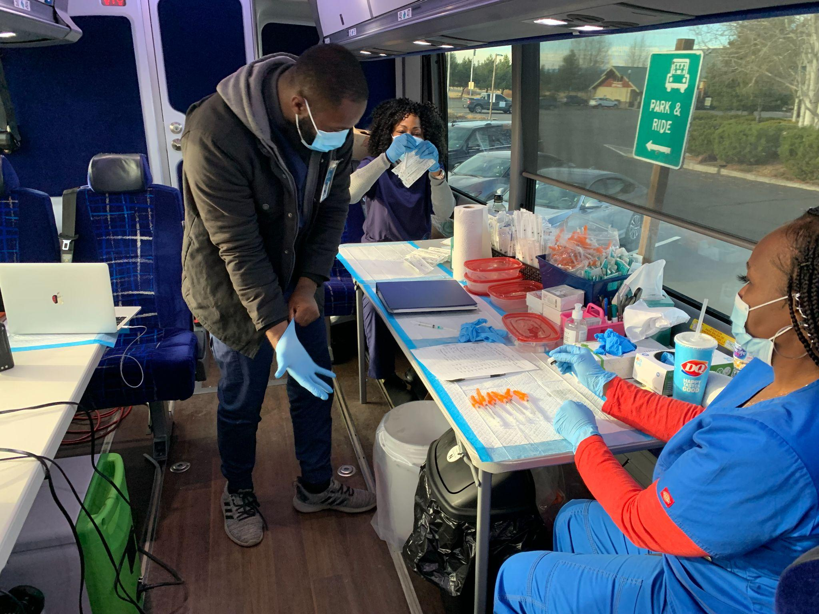
FEMA is returning to New Mexico to help administer vaccine
Four FEMA mobile vaccine teams will return to NM to administer COVID-19 vaccines statewide
NM has requested four vaccine buses to conduct mobile vaccine clinics across the state

Slide 12
Call for Providers: We need your help administering booster doses
If you are a vaccine provider, we need your help, especially in Santa Fe, Española, and Albuquerque
If you are not a provider, consider becoming one: signup at TakeCareNM.org
Providers are trusted! Please share importance of boosters with your patients to address waning immunity and variants
Emphasize that patients don’t need insurance and that the vaccine is free

Slide 13
Call for Communities and Community Organizations: We need your help to promote the COVID-19 vaccine and save lives
New Mexico hospitals are full
Omicron is already in the U.S. and there are still many unknowns about the variant
If you are a community organization or serve in the community as a service provider, share information about how to prevent the spread of COVID-19
Sign up to host a vaccine event – request an event at GetVaxNM.com
Let people know that the vaccine is free and at no cost to the person

Slide 14
COVID-19 Epidemiology Update

Slide 15
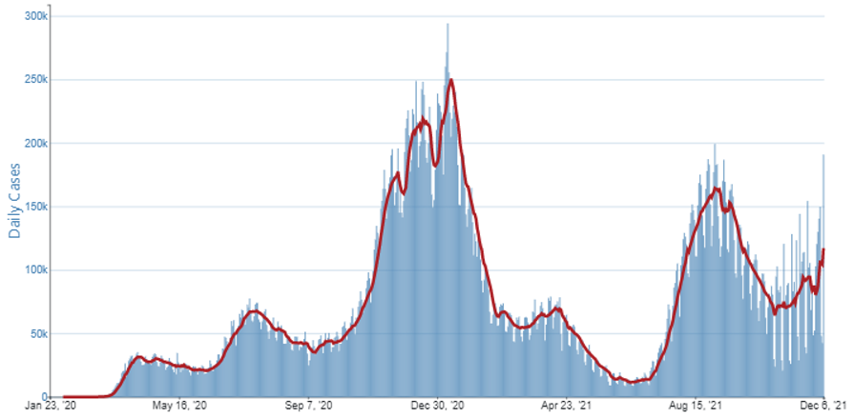
National update – high rate of COVID-19 cases
US COVID-19 7-Day Case Rate per 100,000, by State/Territory
Daily Trends in Number of COVID-19 Cases in the US Reported to the CDC
https://covid.cdc.gov/covid-data-tracker/#cases_casesper100klast7days ; https://covid.cdc.gov/covid-data-tracker/#trends_dailycases

Slide 16
https://cvmodeling.nmhealth.org/
Total NM 7-day rolling average
10 cases per 100,000
Total NM cases

Slide 17
Metro Region Case Count
https://cvmodeling.nmhealth.org/
Notes:
Sandoval, Bernalillo, Valencia, and Torrance

Slide 18
Northeast Region Case Count
https://cvmodeling.nmhealth.org/
Notes:
Sandoval, Bernalillo, Valencia, and Torrance

Slide 19
Northwest Region Case Count
https://cvmodeling.nmhealth.org/
Notes:
Sandoval, Bernalillo, Valencia, and Torrance

Slide 20
Southeast Region Case Count
https://cvmodeling.nmhealth.org/
Notes:
Sandoval, Bernalillo, Valencia, and Torrance

Slide 21
Southwest Region Case Count
https://cvmodeling.nmhealth.org/
Notes:
Sandoval, Bernalillo, Valencia, and Torrance

Slide 22
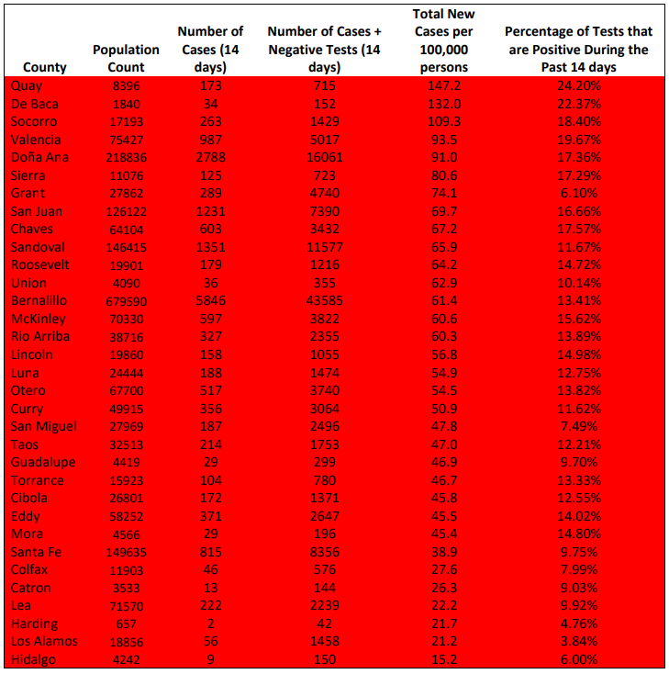
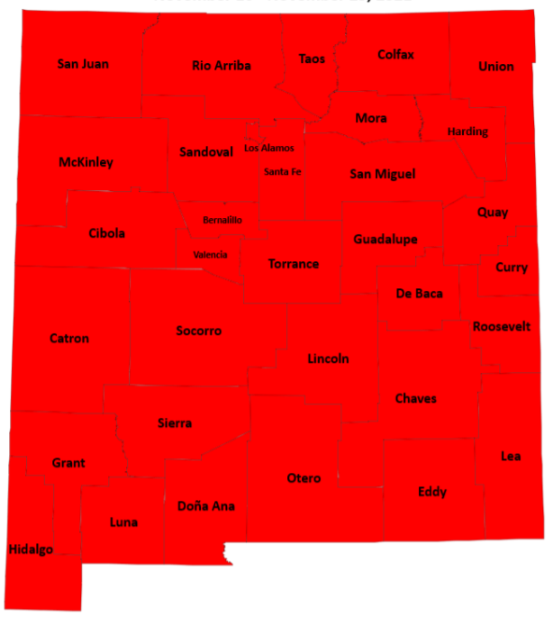
All of NM is a high-risk setting
Levels of Community Transmission by County, November 23 - December 6, 2021
Community Transmission by County Report https://cv.nmhealth.org/epidemiology-reports/

Slide 23
Omicron Variant B.1.1.529
Omicron was designated a new variant of concern by the WHO on 11/26/21
This new variant has been detected in 20 states as of 12/9/21
It has not been identified in New Mexico
Little data is available on Omicron’s spread rate, resistance to vaccine, etc.
US States Where Omicron has been Detected
Tracking Omicron and Other Coronavirus Variants - The New York Times (nytimes.com) 12/7/21

Slide 24
Highly contagious Delta variant remains predominant variant in current surge
Variant of Concern Report https://cv.nmhealth.org/epidemiology-reports/

Slide 25
Vaccine Breakthrough Cases

Slide 26
Percent of Cases, Hospitalizations, and Deaths by Vaccine Status: November 8 – December 6, 2021
Risk of Vaccine Breakthrough case ~4x higher in those who completed initial series prior to 6/1/21, compared to those who completed it after 6/1/2021
Vaccination Report https://cv.nmhealth.org/epidemiology-reports/

Slide 27
NM COVID-19 Hospitalizations and Deaths

Slide 28
Self-evaluation data not collected between 3/3/21 and 8/17/21.

Slide 30
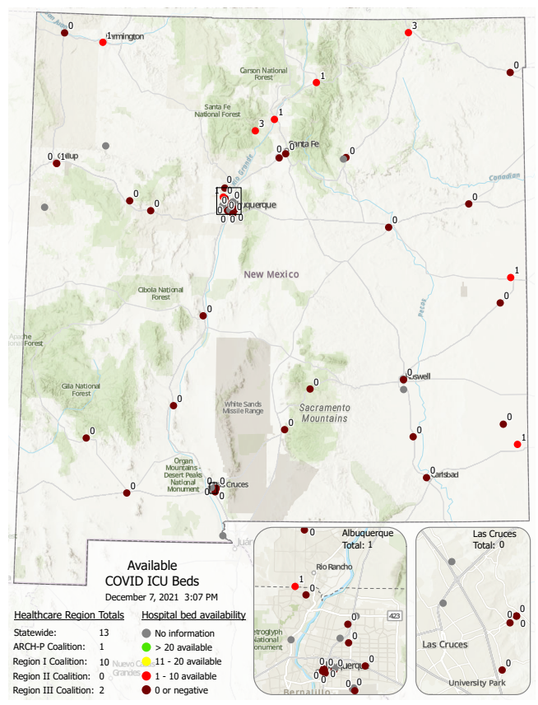
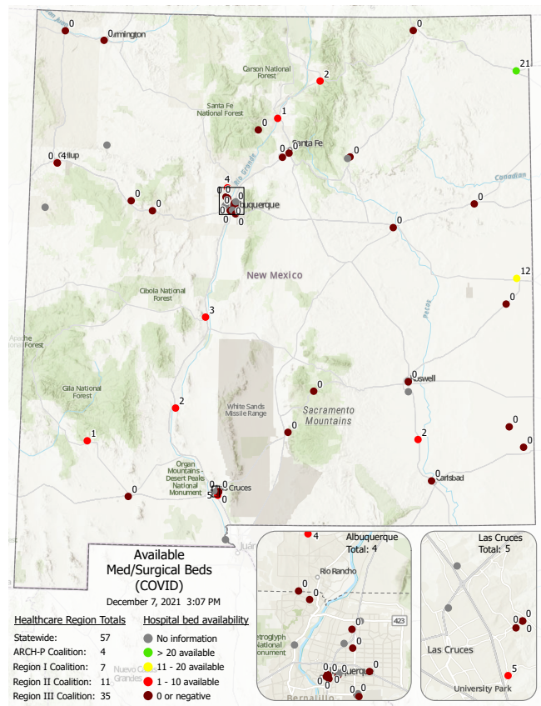
ICU Beds
Med/Surgical Beds
Total beds available: 13
Total beds available: 57

Slide 31
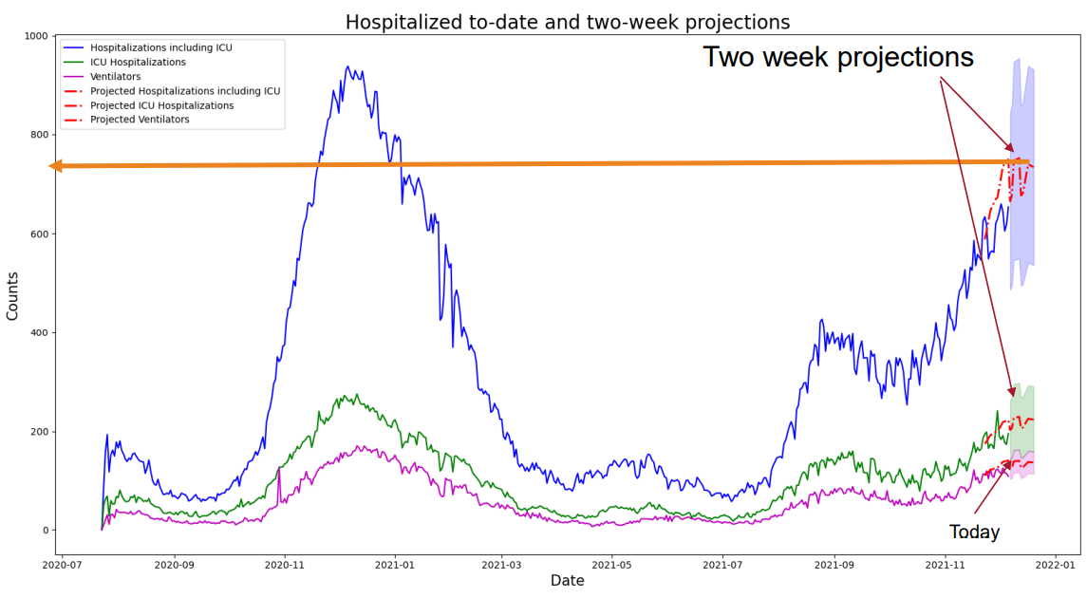
Predictions for NM hospitalizations remain high

Slide 32
Emergency departments are experiencing high levels of patients waiting for a hospital bed
Emergency departments statewide are seeing the highest rates of patients waiting for a hospital bed this year
Yesterday, 2 ABQ hospitals with 65, 90 patients waiting for a hospital bed
Do not delay care, but please do not visit the emergency department or use ambulance unless it is an emergency

Slide 33
Staffing assistance for New Mexico hospitals
Facility | State | Federal
Eastern NM Medical Center (Roswell) | 34
Lovelace Medical Center and Heart Hospital (ABQ) | 31
San Juan Regional Medical Center (Farmington) | 26 | 73
Gallup Indian Medical Center (Gallup) | 24
Memorial Medical Center (Las Cruces) | 24
Mountain View Regional Medical Center (Las Cruces) | 21
Carlsbad Medical Center (Carlsbad) | 18
Gerald Champion Regional Medical Center (Alamogordo) | 17
Alta Vista Regional Hospital (Las Vegas) | 17
Lovelace Westside Hospital (ABQ) | 4
Lovelace Women's Hospital (ABQ) | 4
Los Alamos Medical Center (Los Alamos) | 4
Mimbres Memorial Hospital (Deming) | 3
TOTAL | 227 | 73
99
24
4
17
39
34
17
45
18
Staffing assistance is 100% reimbursable by FEMA
3
Total: 300

Slide 34
New state actions to expedite hospital discharges to nursing homes
Letter of Direction from ALTSD and DOH to nursing homes
Order from Secretary of HSD to Medicaid managed care companies
Emergency Order from Superintendent of Insurance to commercial insurers
Together, they remove “prior authorization” step for hospital discharge to skilled nursing facility

Slide 35
How bad is it in our NM hospitals?
Generally, the vast majority of hospitals state this is “the most difficult challenge they have ever faced.”
Special guest: Michael E. Richards, M.D., M.P.A.
Senior Vice President for Clinical Affairs, UNM Health
Interim Dean, UNM School of Medicine

Slide 36
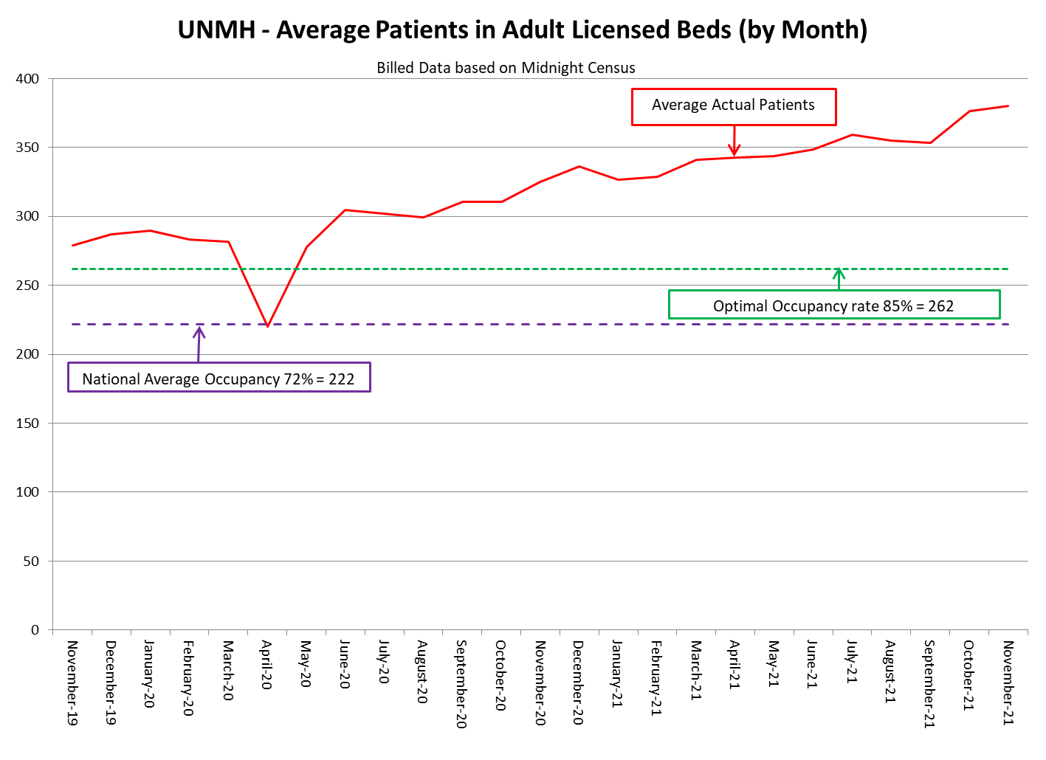
UNM Health System
Brief Operational Update
High Patient Volumes
Focus on Essential Care
Essential Services/Transfers
Surgery Scheduling
Reassignment of Providers
Outpatient Care
Patient Experience
Seek Necessary Care
Vaccinations and Boosters

Slide 37
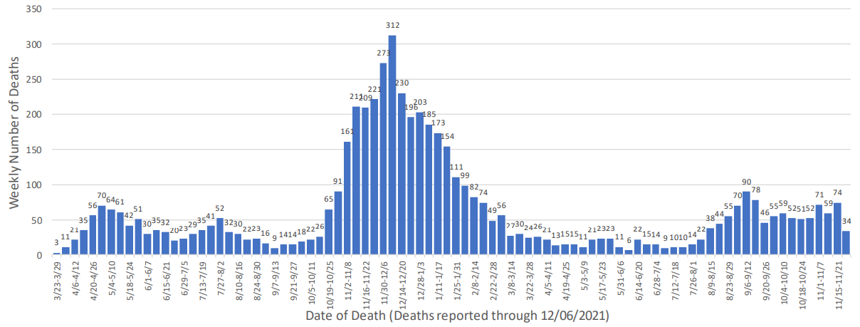
NM’s COVID-19 deaths have plateaued at a high level
5,445 New Mexico deaths as of 12/08/21
Mortality Report https://cv.nmhealth.org/epidemiology-reports/

Slide 38
COVID-19 Treatments

Slide 39
1,163 mAbs doses given this week!

Slide 40
mAbs provider spotlights
Below are the top outpatient mAbs providers from December 2-8. “Thank you!” to these facilities and all other NM mAbs providers:
Presbyterian Hospital System – 327
Memorial Medical Center – 109
Eastern New Mexico Medical Center – 100
San Juan Regional Medical Center – 96
Gallup Indian Medical Center – 84

Slide 41
National Infusion Center: https://infusioncenter.org/

Slide 42
COVID-19 oral therapeutics are expected to arrive in New Mexico next week
FDA advisory group met and approved Molnupiravir 11/30
EUA expected this week from FDA
460 courses expected initially in NM
Timeframe for arrival: Week of December 13
Central pharmacy model will be used initially for distribution
Must be taken within 5 days of symptom onset
Initial priority given to those in locations without mAb access

Slide 43
PROTECT YOURSELF AND OTHER NEW MEXICANS: Add Your Phone To Fight Covid
Assist with contact tracing efforts and help slow the spread of COVID-19
Users input their positive test results in the App, and devices alert other users using Bluetooth if exposure occurs
Everything is completely anonymous
No personal information is collected or shared
App does not use GPS or location services that would identify your location or your movement
Opt-in activation on Apple and Google Play: Search for NM Notify in app store
Photo: https://www.dailylobo.com/article/2021/04/nm-notify-helps-track-covid-exposures

Slide 44
PROTECT YOURSELF AND OTHER NEW MEXICANS: Add Your Phone To Fight Covid
534,982 estimated total activations (36% of New Mexicans 18+)
40,167 Android
494,815 iOS

Slide 45
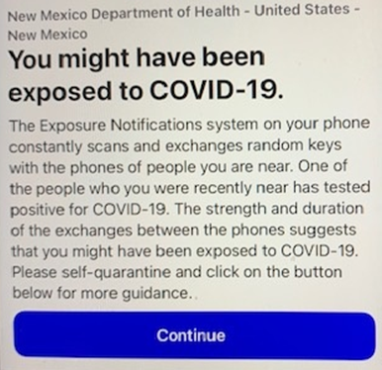
PROTECT YOURSELF AND OTHER NEW MEXICANS: Add Your Phone To Fight Covid
If YOU get an exposure message:
Get tested immediately
If symptomatic, stay home until you get your test results

Slide 46
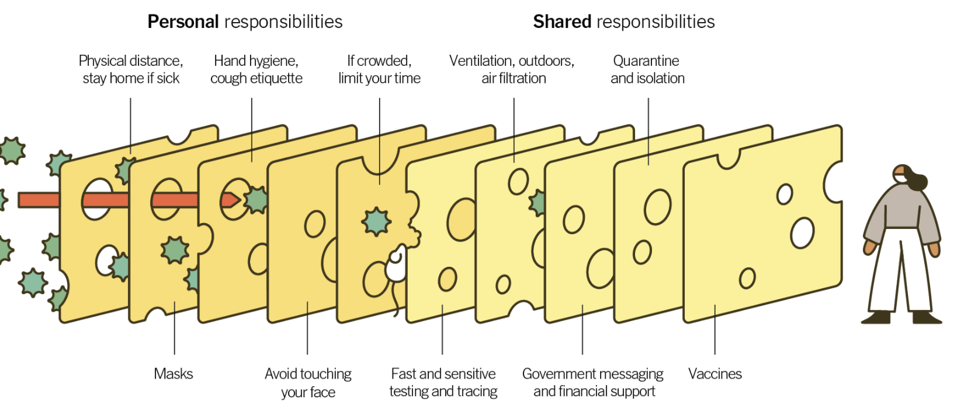
Multiple layers to help prevent the spread COVID-19 – NM needs your help!
and boosters
https://www.nytimes.com/2020/12/05/health/coronavirus-swiss-cheese-infection-mackay.html

Slide 47
The pandemic is not over; Get vaccinated, get boosted!
Get tested if you think you have COVID-19 or have been exposed to someone who is positive.
If you have a COVID-19 positive test, symptoms and risk factors, seek out monoclonal antibody treatment.
Be especially careful indoors no matter where you live in NM.
CASE COUNTS REMAIN TOO HIGH. WE ALL STILL MUST FIGHT THE VIRUS.
Wash hands, clean surfaces, cough into tissue/elbow.
Everyone mask up and maintain social distancing (minimum 6’).
Get needed preventive healthcare.
Get vaccinated!

