Slide 1
COVID-19 Day 701 Press Update
February 9, 2022
DOH Acting Secretary David R. Scrase, M.D., M.H.S.A.
HSD Manager, Strategic Planning & Special Projects Alex Castillo Smith

Slide 2
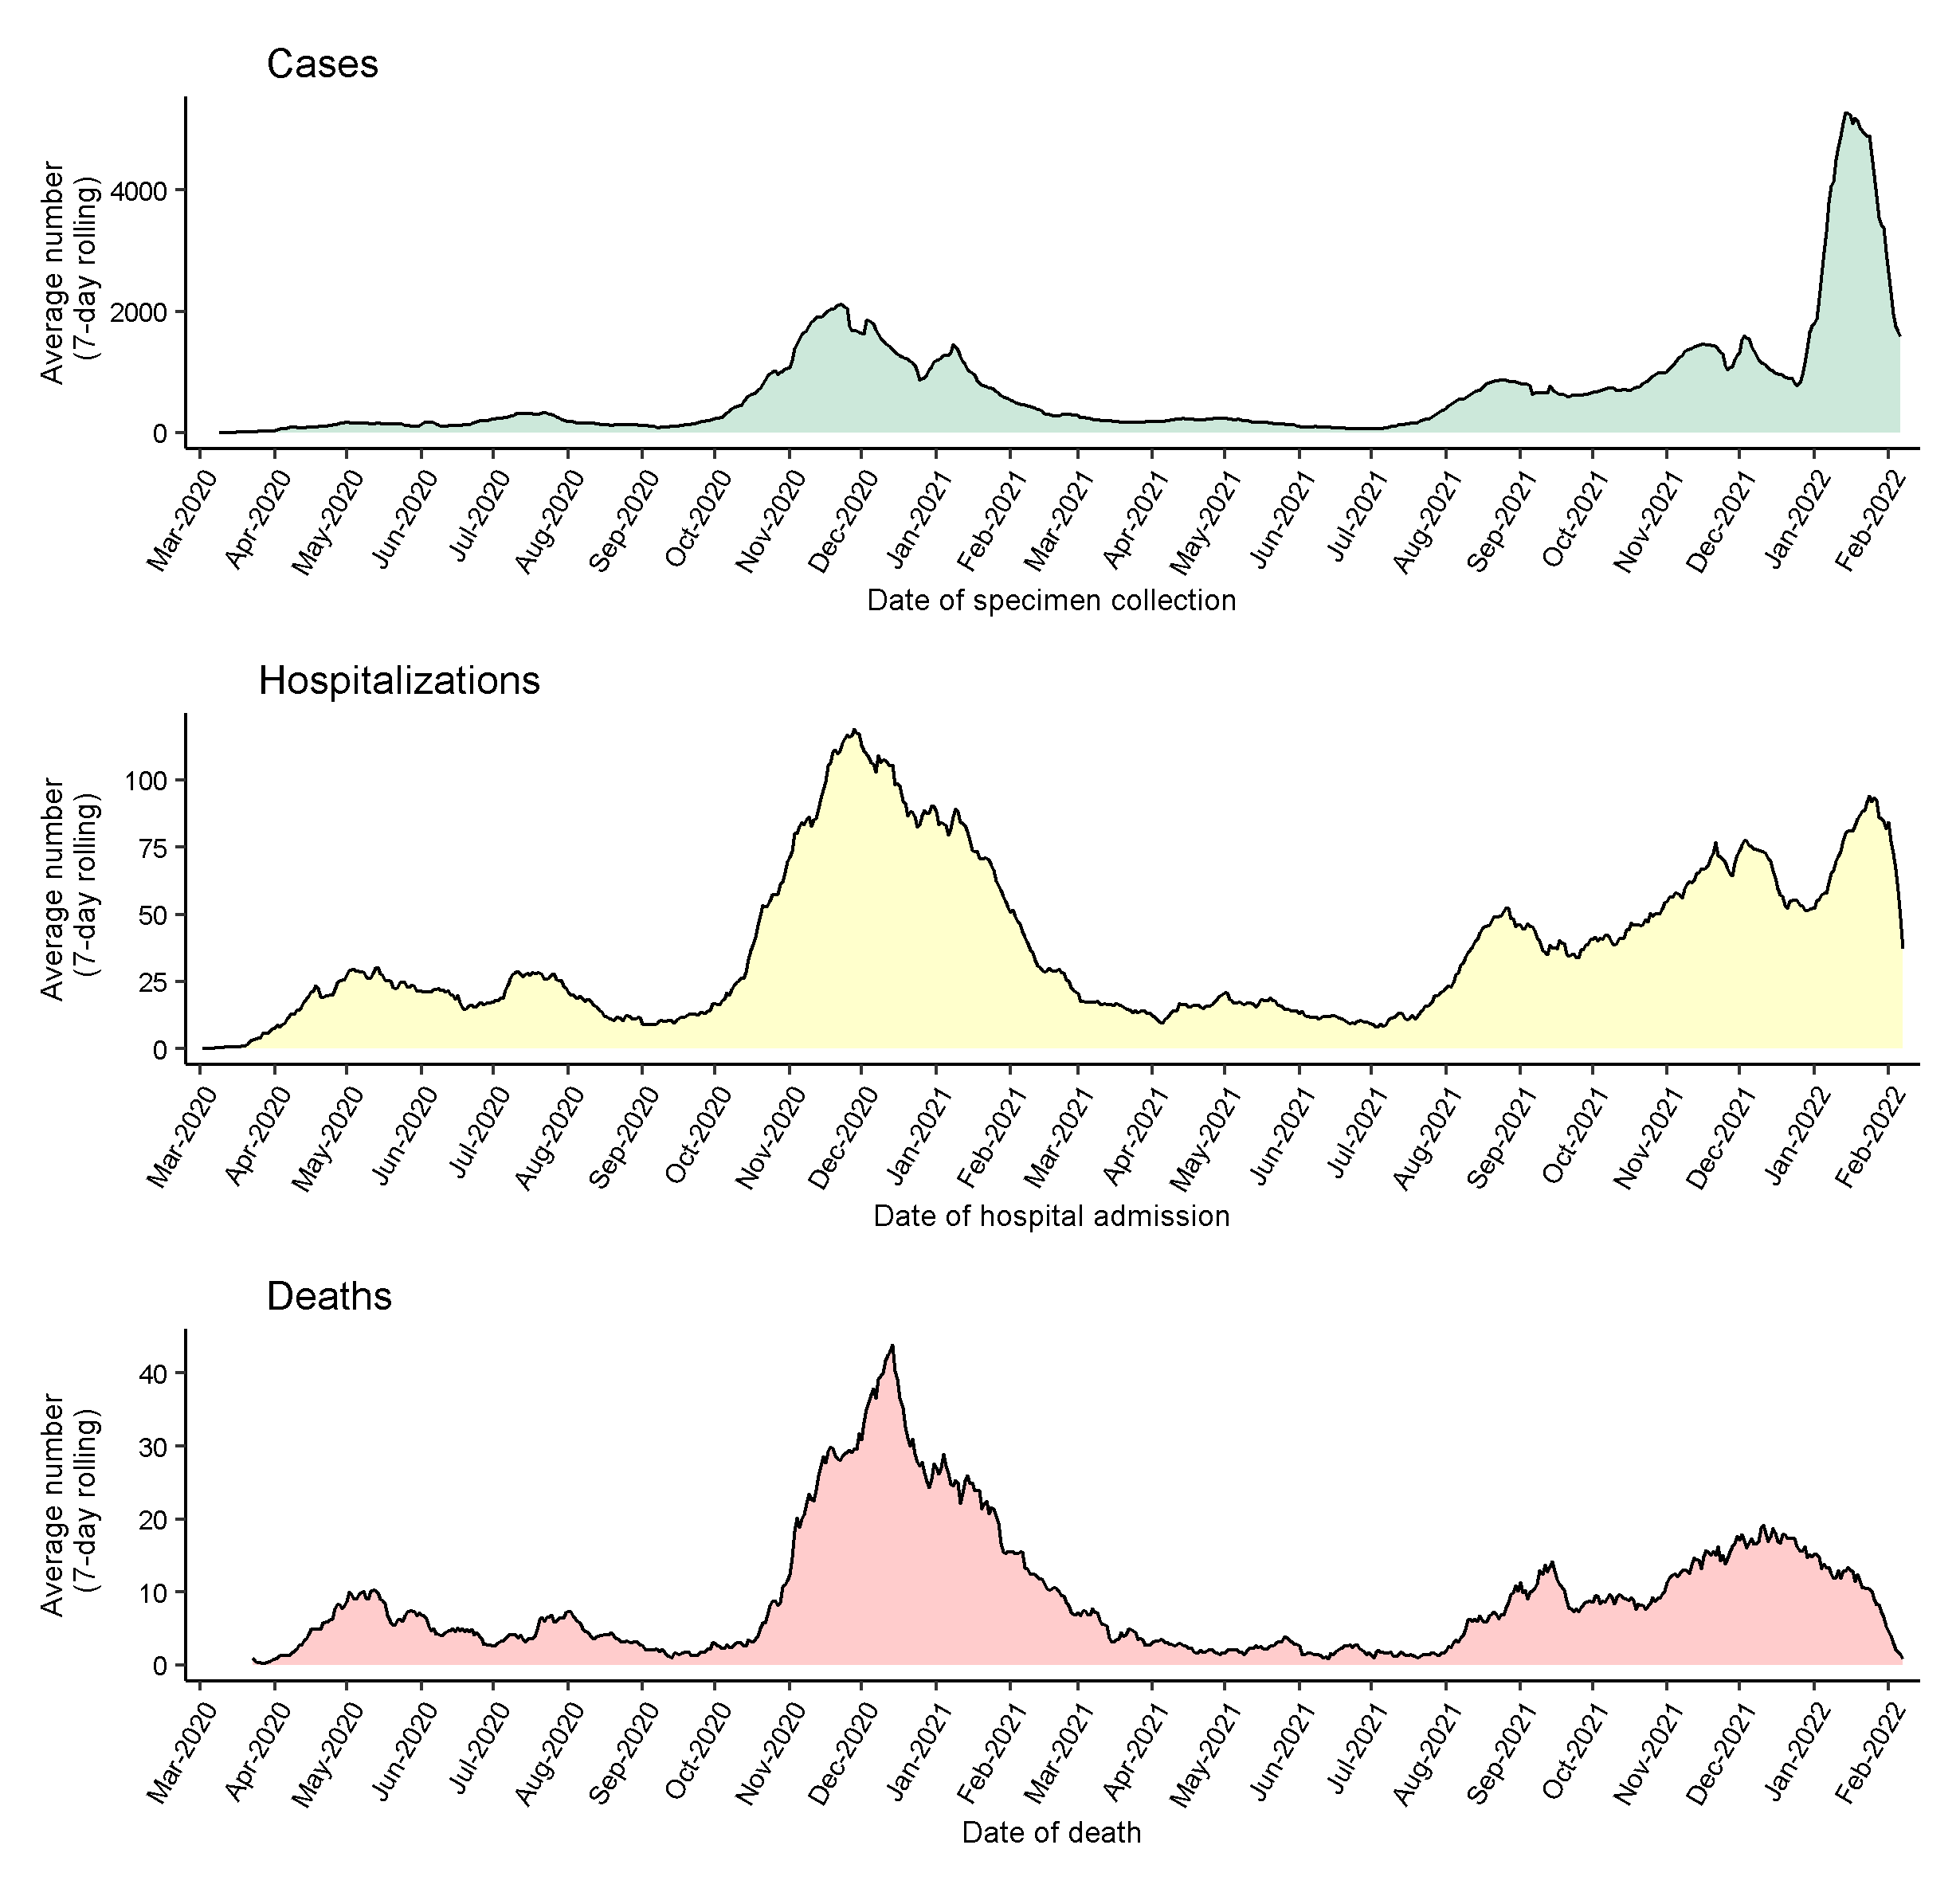
COVID-19 Cases, Hospitalizations, and Deaths
Total Cases | Last 7 Days | Total Cases % of NM
494,368 | 13,432 | 23.5%
Total Hospitalizations | Last 7 Days | Total Hosp. % of Cases
24,954 | 370 | 5.0%
Total Deaths | Last 14 Days | Total Deaths % of Cases
6,555 | 78 | 1.3%

Slide 3
COVID-19 Vaccine Update
New Mexico Vaccination Rates
 | 5-11 | 12-17 | 18+
Primary Series Completed | 26.0% | 60.0% | 77.5%
Received First Dose | 36.7% | 70.5% | 91.4%
63.7% of eligible New Mexicans have received a booster dose 18+: 694,853, 42.8% (all NM) 12-17: 25,581, 15.3% (all NM)
COVID-19 Vaccine News
Last week, Moderna received full approval by the FDA and CDC as a two-dose vaccine series for prevention of COVID-19.
COVID-19 vaccine may be available soon for children under 5 years old. Pfizer recently submitted data to the FDA for children 6 months through 4 years old for EUA.
Roll-out plan is complete, NMDOH is placing vaccine orders this week.
NM needs providers to administer this vaccine. Please sign up today at TakeCareNM.org to become a provider.
2/8/22 https://vaccinenm.org/public-dashboard.html
CDC Statement Following ACIP Moderna Vote | CDC Online Newsroom | CDC
https://www.pfizer.com/news/press-release/press-release-detail/pfizer-and-biontech-initiate-rolling-submission-emergency

Slide 4
NM Hospital Employee Vaccination Rates
As of January 31, 2022:
88.4% of New Mexico’s hospital employees have completed their primary series
74.8% have received their booster dose
4.9% are only partially vaccinated
5.9% have an approved exemption
0.8% remain unvaccinated
Only 4 NM hospitals did not report.

Slide 5
Fact Check: “Four States have ended their mask mandates as of yesterday.”
State | School Mask Mandate in place? | End to school mask mandate announced? | Possible date to end mask mandate | Statewide 7-day average case rate per 100,000 | Statewide 7-day average hospitalization rate per 100,000
NJ | Yes | Yes | 3/7/22 | 33 | 28
CT | Yes | Yes | 2/28/22 | 36 | 24
DE | Yes | Yes | 3/31/22 | 49 | 37
OR | Yes | Yes | 3/31/22 | 96 | 30
NM | Yes | No | ? | 97 | 33

Slide 6
Effectiveness of Face Mask or Respirator Use in Indoor Public Settings for Prevention of SARS-CoV-2 Infection, CA, Feb.–Dec. 2021 CDC
Researchers enrolled California residents who received positive (case-participants, n = 652) or negative (control-participants, n = 1,176) SARS-CoV-2 test result, during 2/18/21–12/1/21.
Participants indicated whether they had been in indoor public settings in 14 days before testing and whether they wore face mask or respirator all, most, some, or none of the time.
Consistent use of face mask or respirator associated with lower odds of positive SARS-CoV-2 test result (adjusted odds ratio (aOR) = 0.44).
Use of respirators (N95/KN95) provided most protection.
N95/KN95 (aOR = 0.17) or surgical mask (aOR = 0.34) associated with lower aOR of positive test result compared with not wearing mask.

Slide 7
Schools in high-incidence communities can limit in-school COVID-19 transmission by masking and implementing other mitigation strategies.
March 2021 UT study found low school-associated transmission (0.7% secondary attack rate), in part, due to 86% student masking adherence rate.
May 2021 GA study found COVID-19 incidence 37% lower in schools that required teachers and staff to use masks.
Sept. 2021 analysis found U.S. counties without school mask requirements experienced larger increases in pediatric COVID-19 case rates after start of school compared with counties with school mask requirements (p<0.001).
Oct. 2021 AZ study found odds of school-associated COVID-19 outbreak without mask requirement 3.5x higher than those in schools with mandate in place when school year began (OR = 3.5).
https://www.theatlantic.com/ideas/archive/2022/01/kids-masks-schools-weak-science/621133/

Slide 8
NM MAT Review of Mask Effectiveness
The NM Medical Advisory Team has been reviewing studies regarding mask effectiveness since March 2020.
Multiple summaries of the medical literature are available online: https://cvmodeling.nmhealth.org/medical-advisory-team/
The majority of studies support effectiveness of masks in reducing spread of COVID-19.
We are open to reviewing studies with differing viewpoints.

Slide 9
Epidemiology Report of the Week
Weekly COVID-19 epidemiology reports are posted at the end of the day on Tuesdays at:
https://cv.nmhealth.org/epidemiology-reports/
Today, we’ll walk through the Pediatric Case Report.

Slide 10
NM Crisis Standards of Care will be Renewed to Support our Hospitals
NM hospitals are still operating at >100% capacity, particularly in Albuquerque.
Crisis Standards of Care renewal will happen this week.
404 additional healthcare staff contracted by NMDOH to assist.
>1,200 additional healthcare staff contracted by Albuquerque hospitals.

Slide 11
Hospitals are Still Battling the Pandemic – Visit FindaTestNM.org for a COVID-19 Test
Mail order or pick-up at-home COVID-19 tests for when you need them!
Free at-home tests are available for every New Mexico household, shipped to the home.
Free at-home COVID-19 tests have been distributed in New Mexico communities for pick-up while supplies last.
PCR laboratory testing locations for people experiencing symptoms: If you are experiencing COVID-19 symptoms and need a test now, you can also find a PCR laboratory test location near you.
Please do not visit the emergency room unless you are experiencing a medical emergency.

Slide 13
Takeaway Messages
Cases are going down, but New Mexicans still need to mask up.
Help our hospitals! Visit FindaTestNM.org to locate a COVID-19 test unless you’re experiencing a medical emergency.
We are all at risk of COVID-19; Stay up to date on your vaccine.

